Slide 1



NAME: OTTIH EDOH
Fellow ID: FE/23/62131531 Cohort 2
DATA SCIENCE WEEK 11
Weekly Applied Learning Assignment
(CAPSTONE PROJECT)
Project topic:
predictive modeling for COVID-19 in public health:

Slide 2


Slide 3
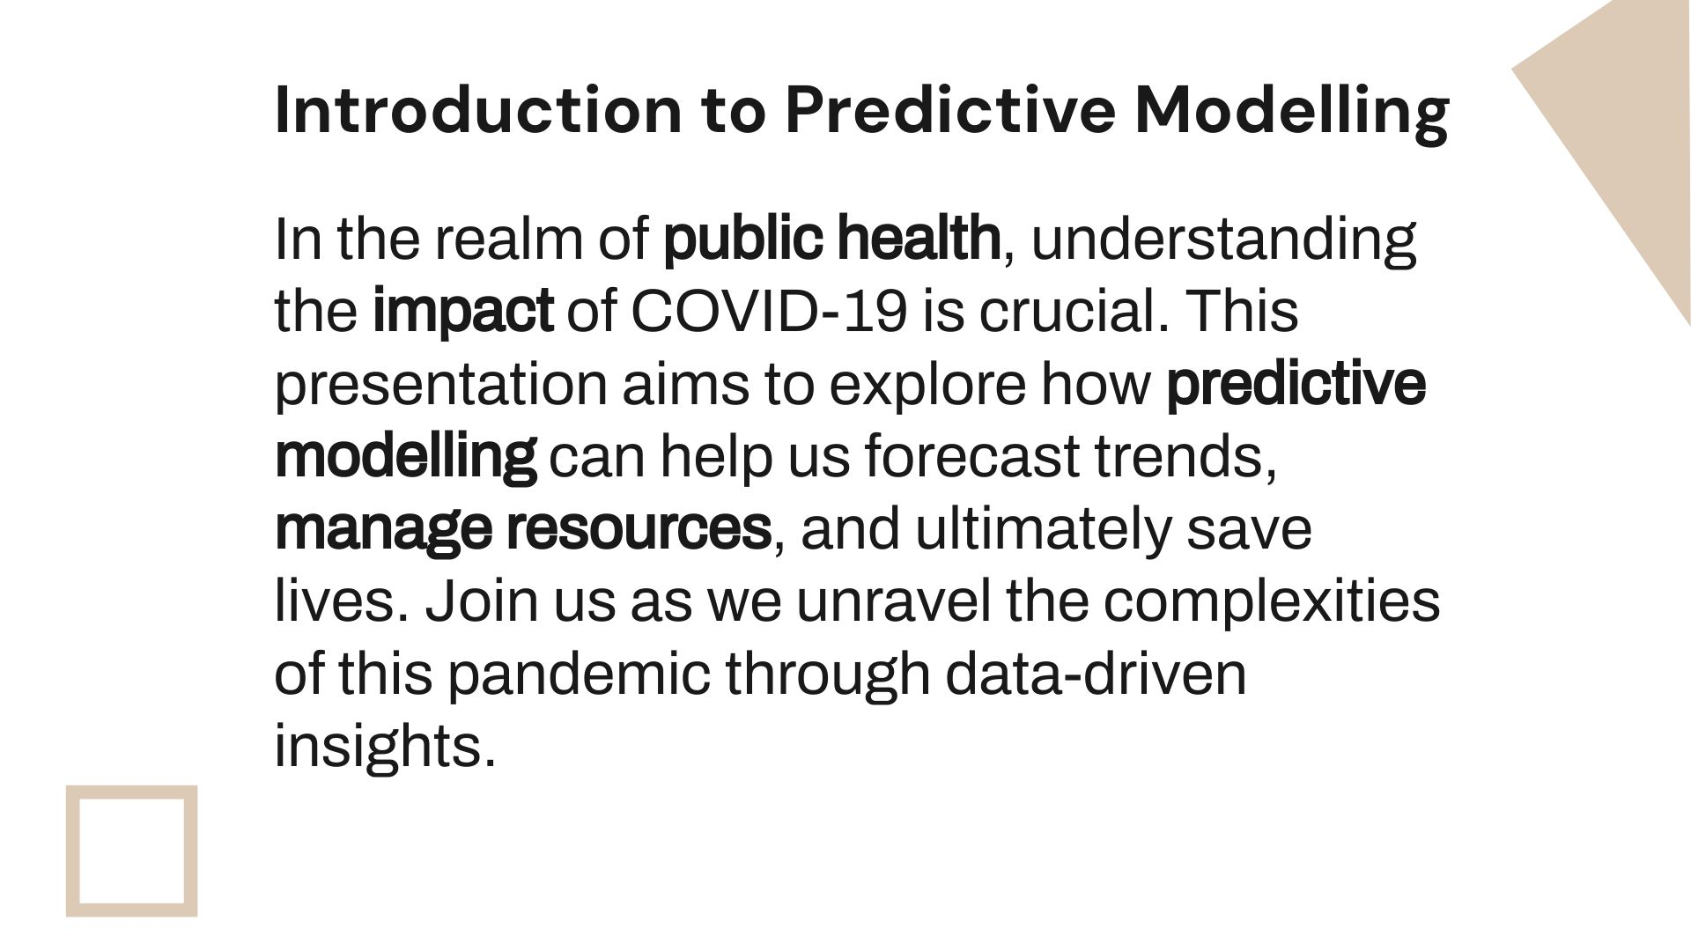

Slide 4
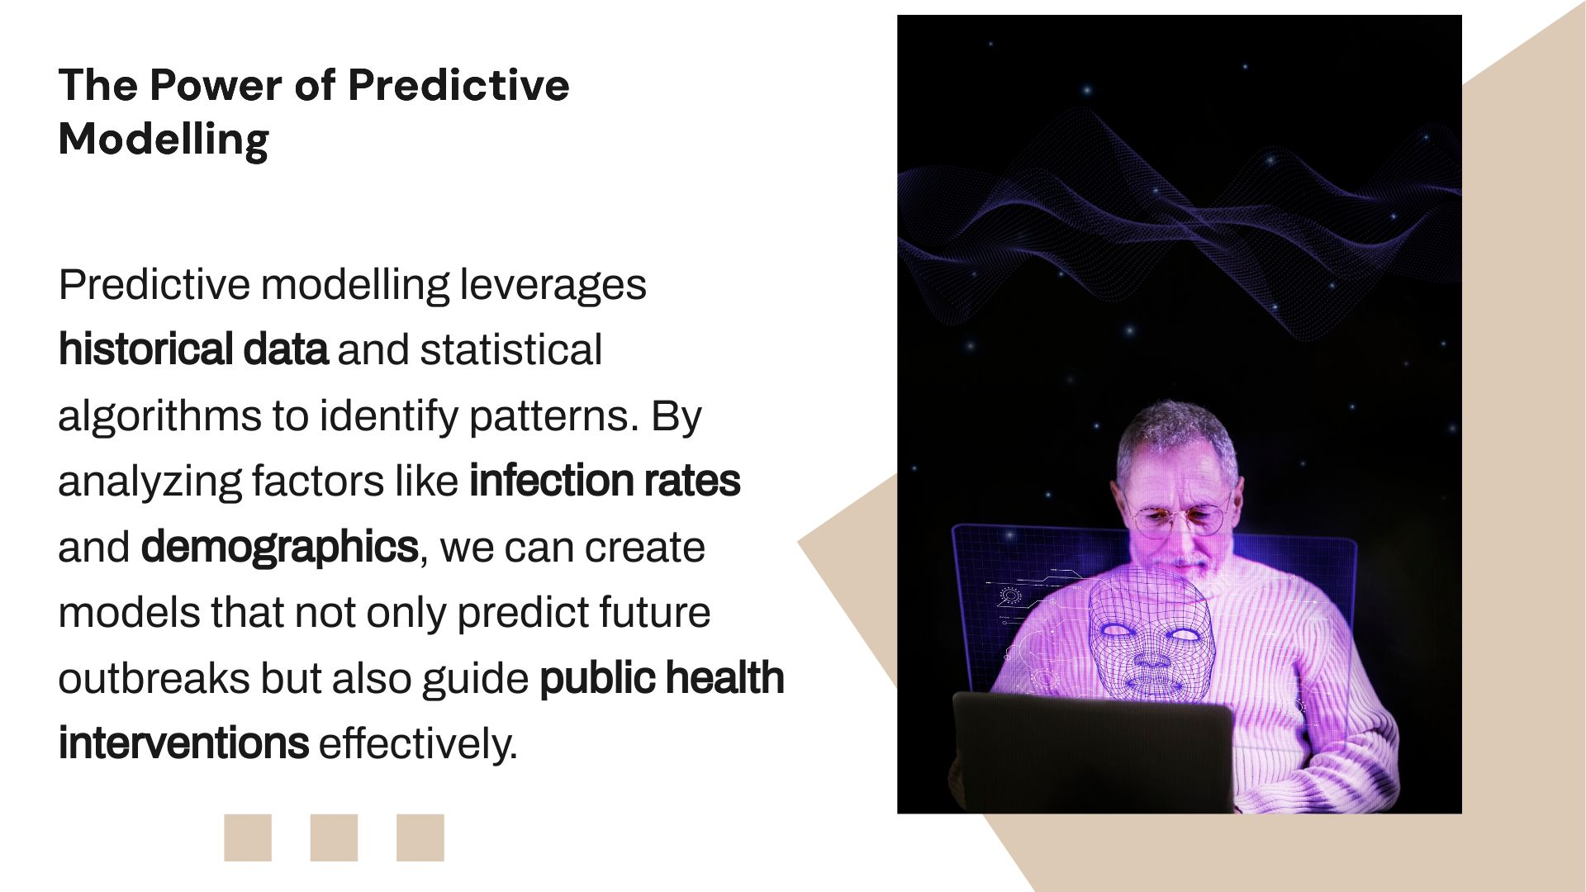

Slide 5
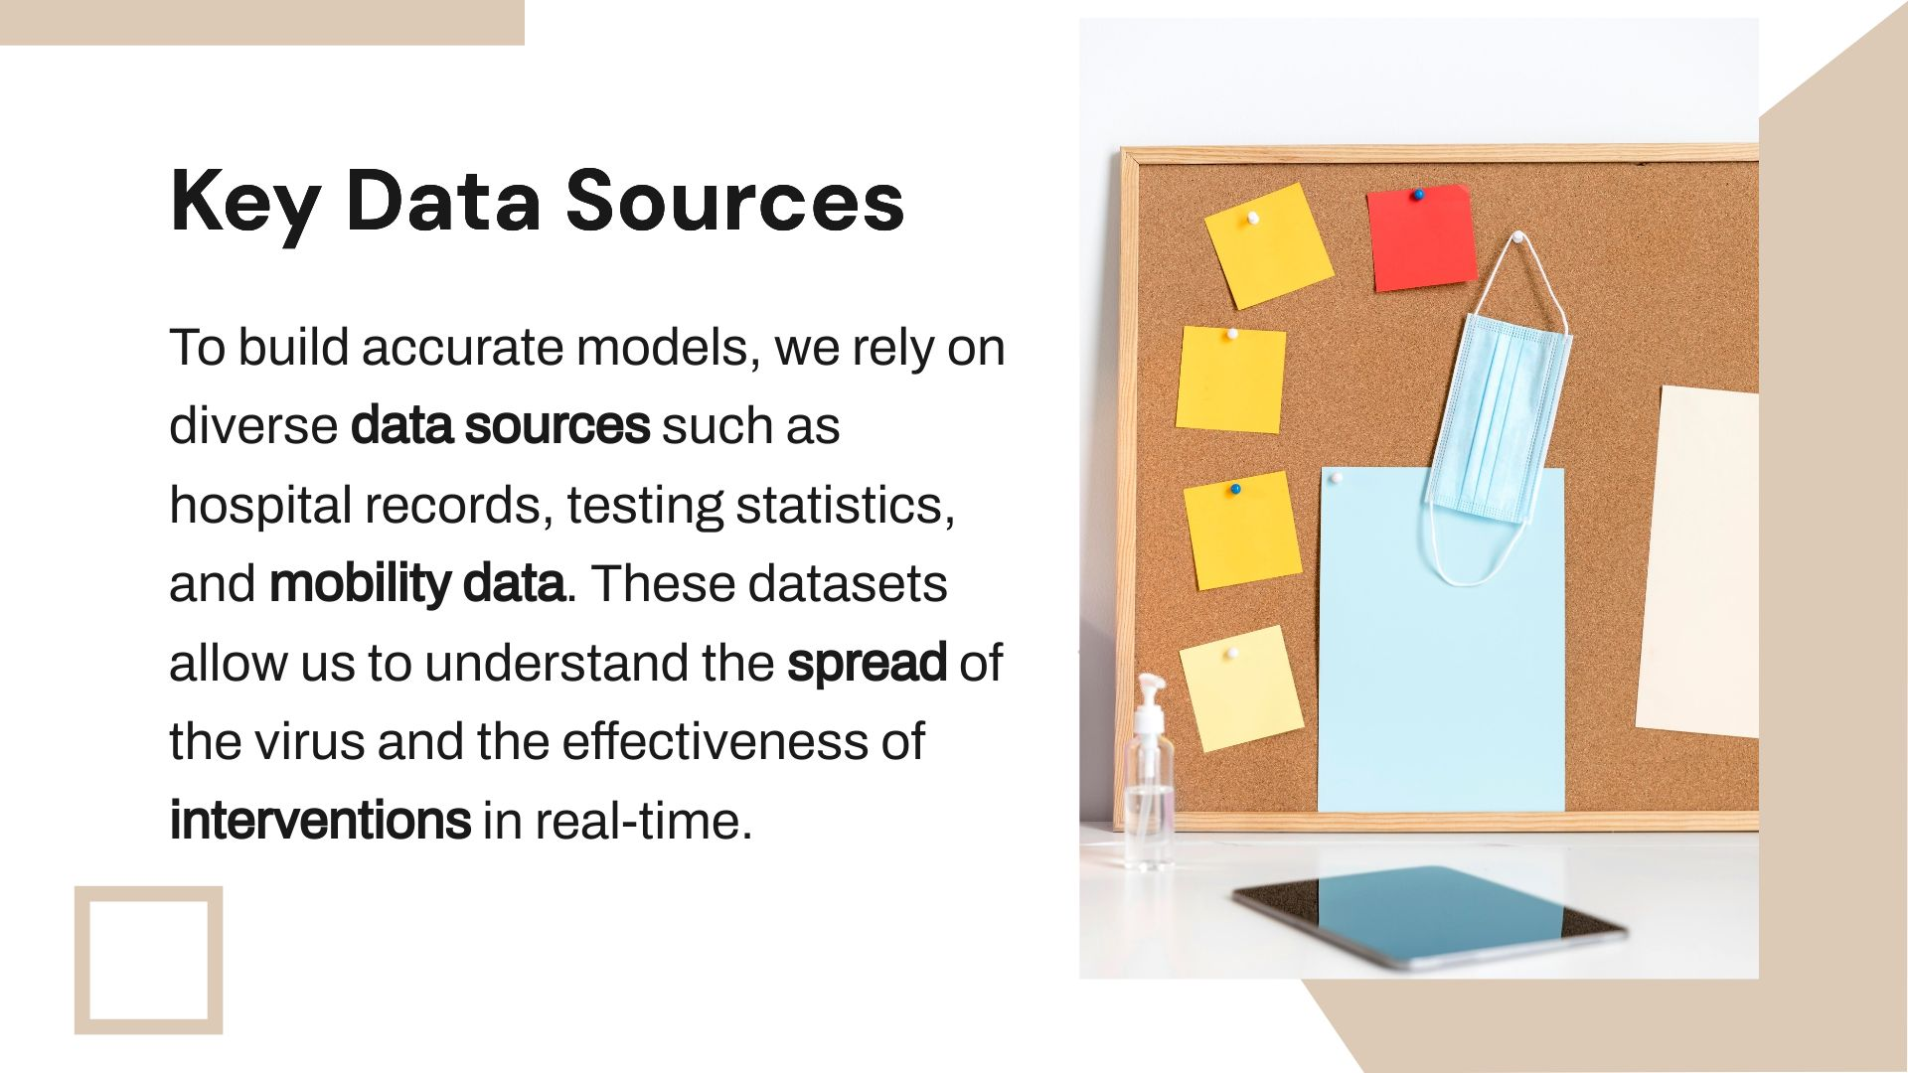

Slide 6
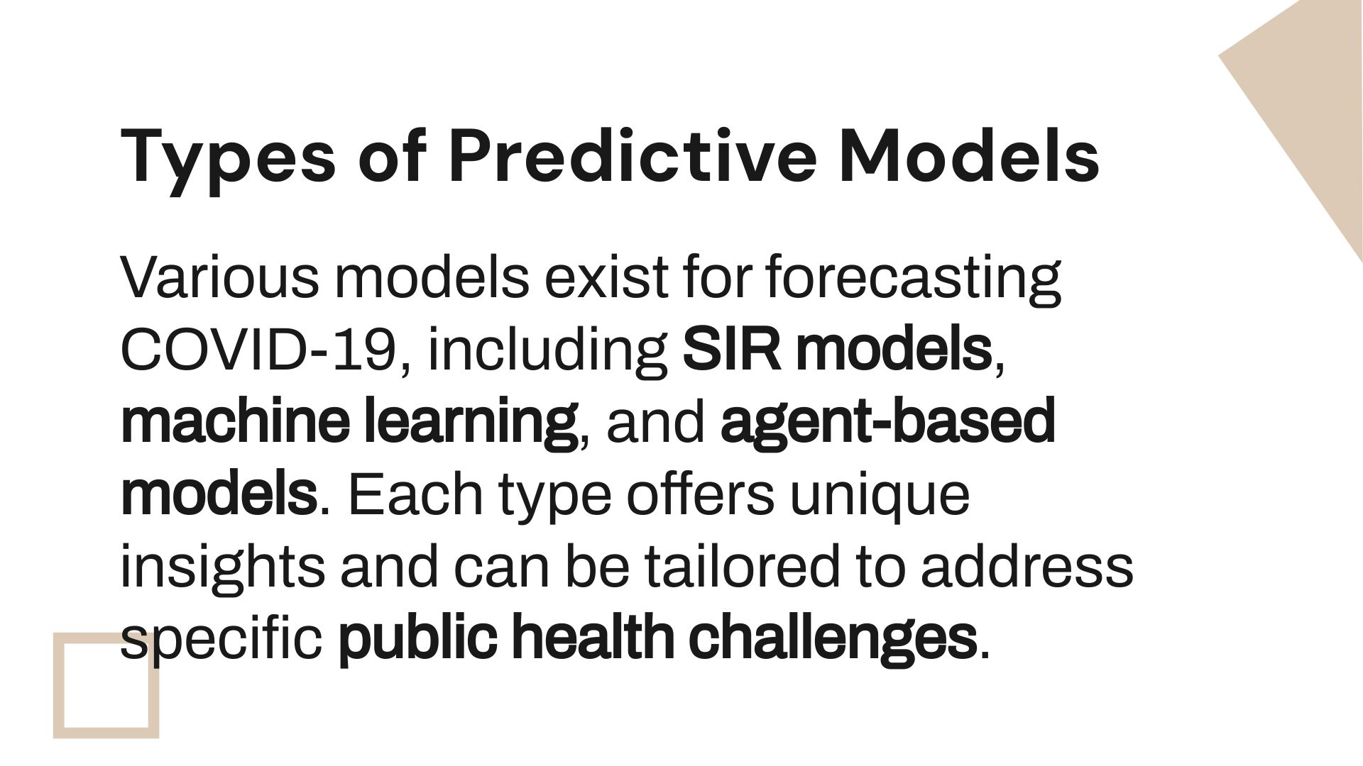

Slide 7
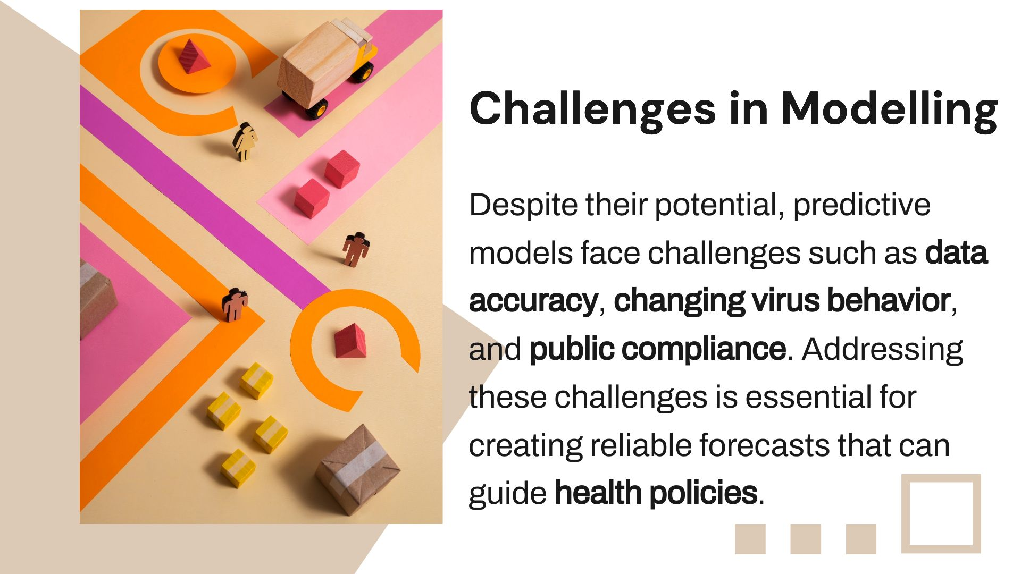

Slide 8
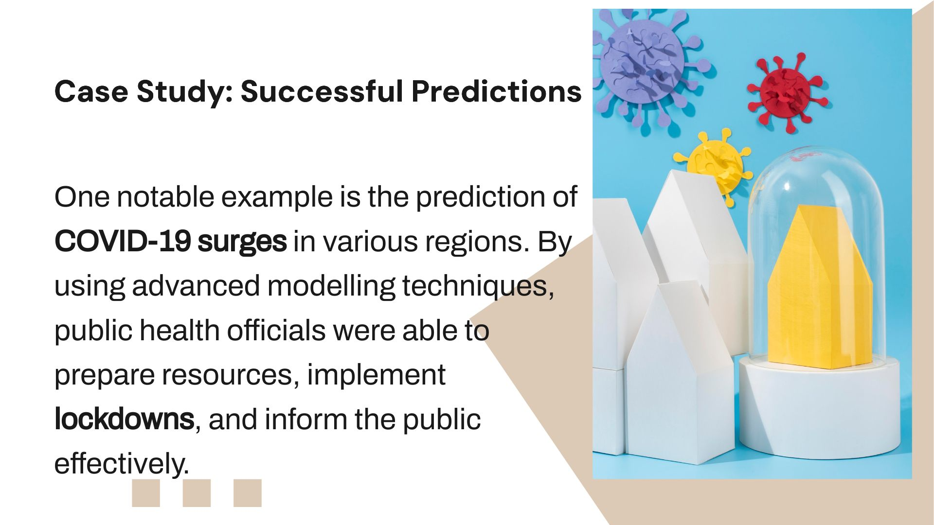

Slide 9
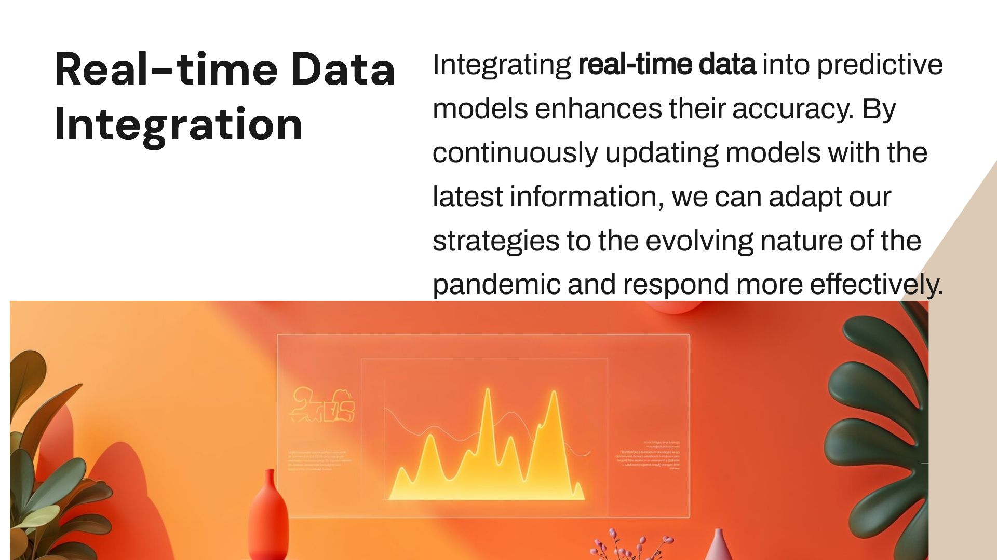

Slide 10


Slide 11


Slide 12


Slide 13


